Slide 1

3rd JTC1 workshop
Status for meeting JTC1 pr 1st May 2022
Title: Impact of global changes on landslide risk
Oslo, 7-10 June 2023
Website: https://jtc1-2023.com/

Slide 2
Title: Impact of global changes on landslide risk
Aim: Promote discussion among scientists, engineers, decision-makers and other stakeholders on whether we are capable of predicting and quantifying the expected changes in landslide hazard and risk and how we can implement the knowledge from academic research on landslide risk management into practice.
Topics in focus:
Rock mass degradation and landslide initiation;
Climate and anthropogenic impact on landslide risk in various geographic regions, including the Arctic;
Prediction of landslide mobility and inundation, including landslides initiated at mine tailings storage facilities;
Application of modern remote sensing technologies to landslide risk assessment;
Landslide risk reduction strategies: risk mitigation, including early warning and nature-based solutions;
Applications of new technologies like machine learning for landslide susceptibility and landslide hazard mapping

Slide 3
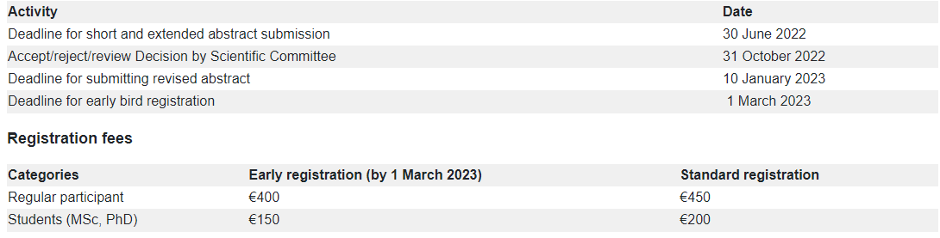


Dates, deadlines and registration
Deadline for abstract submission, extended until 30 June 2022
Contributions are to be submitted in a pdf format via e-mail to this address: jtc12023@ngi.no
Submissions received will be acknowledged by return e-mail.

Slide 4







Keynote speakers
Keynote lecturers invited by the Scientific Committee and Hutchinson Lecture, with geographical diversity and gender balance.
 | Name | Organisation | Specialty
1 | Jonathan Godt | USGS, USA | Monitoring and understanding the hydro- and mechanics of landslide initiation
2 | Jean Hutchinson | Queen's University, Canada | Application of modern remote sensing technologies to landslide risk assessment
3 | Zhongqiang Liu | Norwegian Geotechnical Institute, Norway | Machine learning, landslide risk assessment
4 | Alexia Stokes | INRAE, France | Soil bioengineering & NBS for landslide hazard mitigation
5 | Giovanni Crosta | University of Milano-Bicocca, Italy | Engineering Geology, Landslides, Rock Mechanics, Hydrogeology, Geomorphology
* | Clarence Choi Hutchinson Lect’er | The University of Hong Kong (HKU), Hong Kong | Physical modelling of landslide propagation
Vittoria, Farrokh to send an email to the IAB to inform about the keynote speakers

Slide 5






Steering Committee
NVE: Dr Lars Harald Blikra (Norw. Water Resources & Energy Directorate)
NTNU: Professor Vikas Thakur (Trondheim, Norway)
UiT: Professor Louise Mary Vick (University of Tromsø)
NGU: Professor Reginald L. Hermanns (Geological Survey of Norway)
UiO: Professor Karen Mair (University of Oslo)
UNIS: Professor Gijs Breedveld (The University Centre in Svalbard)

Slide 6


Organisation – Responsibilities of committees
Main tasks | Organising committee (OC) | Steering Committee (SC) | Scientific Commitee (ScC | International Advisory Board (IAB)
Organization of the event | x | x
Topics of the event | x |  |  | x
Technical programme | x | x | x
Selection of keynote speakers and invited speakers |  |  | x
Advice on keynote speakers |  | x |  | x
Evaluation of abstracts |  |  | x
Practicalities during the event | X | x
Organize field excursion on Saturday | x | x
ISSMGE;ISRM; IAEG; IGS
Notes:
Organizing Committee - internal at NGI – takes care of the main organization, creating the website, renting the venue, organizing the field visit etc.
Steering Committee – Norwegian members – is informed by the Organizing Committee about the main decisions taken and can suggest/propose changes to the organization of the event (e.g. express concerns about the dates, sponsor some of the activities, organize the poster session, make a proposal for the icebreaker, provide practical help during the event etc.).
Scientific Committee – Prepares a list of recommended keynote lecturers (5) (other than the Hutchinson Lecturer) and the invited lecturers (8) in line with the theme and topics of the workshop; prepares the scientific program for the workshop (Day 1 and Day2); evaluate the abstracts and accept or reject them for the workshop.

Slide 7
Sessions and topics – after discussion with SC
The title and topic of each session will be decided based on the abstracts submitted, reflecting one of the already identified topics. Each abstract will have keywords, so we will be able to identify to which session that abstract belongs. Each technical session will have an invited lecturer.
There will be 5 Technical sessions and 1 Poster Session
There will be a poster session in the afternoon of the first day, especially for young researchers and students. We are thinking of raising the recognition of the poster session and to have keynote posters (with big names invited), to send specific invitation for giving a poster presentation, which hopefully will attract more people to the poster session, and make it more attractive for younger people to have a poster.
Poster session
The topic of each session will be announced after the 30th of June

Slide 8
Invited speakers
Five invited speakers are expected, to be linked to each of the technical sessions. 20 minute presentation at the beginning of each technical session.
The names of the invited speakers will be chosen depending on the number and topics of abstracts we would receive, and the topics of those abstracts regrouped in sessions.

Slide 9
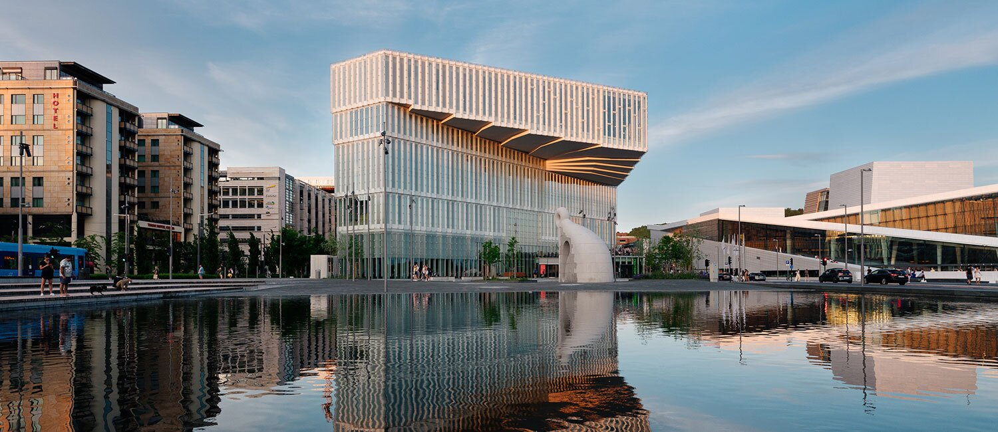
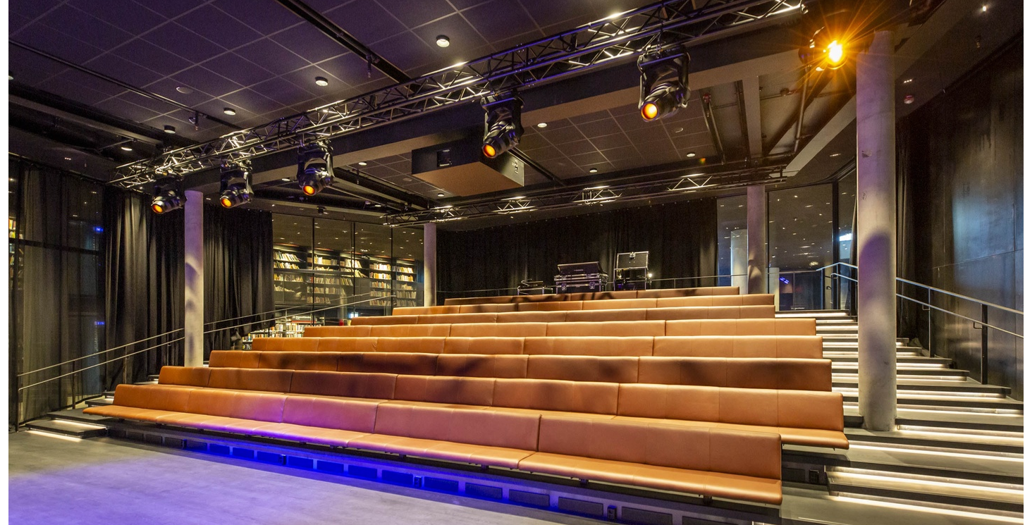
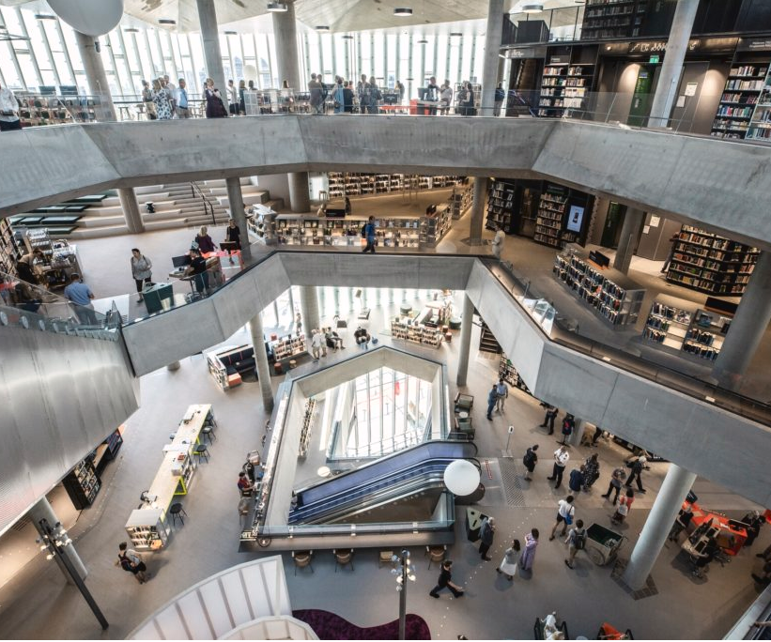
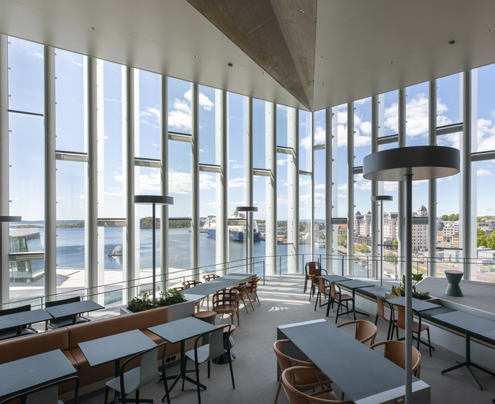
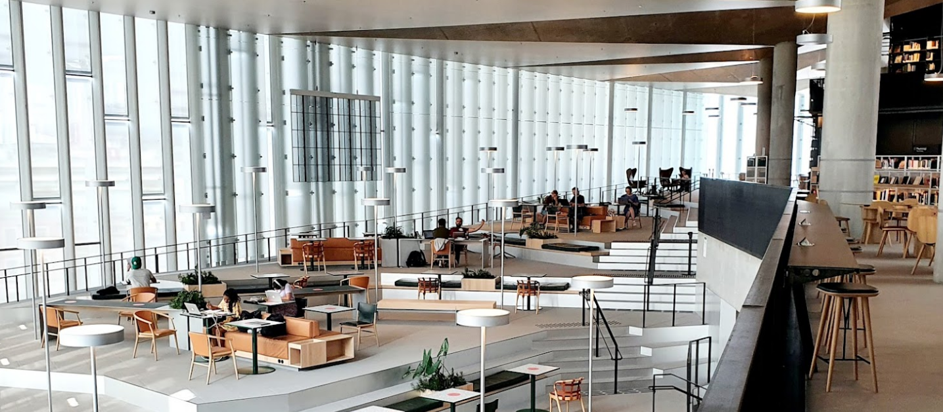
The venue – Deichman library Bjørvika
Conference room
https://deichman.no/bibliotekene/bj%C3%B8rvika
Icebreaker
Notes:
We would appreciate if in their own organization whether they could investigate to fund this event with a certain amount or a lunch or a coffee break
This may not be the cheapest venue. Is there is a minus, NGI will cover this, we considered that with conference fees we are not going to be able to cover all the expenses
Use the mingling area to put up a booth (Stand)
We will most likely ask NFR for covering some of the expenses, it's only a little budget.
Arransjamangt

Slide 10
Two requests/questions to JTC1 members:
1)
We need more abstracts, could you promote the workshop in your organisations and network?
2)
What is your opinion about «raising the level» of the Poster session? Is that a positive development in your view?

